Slide 1
Selecting the Best City for a Dispensary
Jordan Meyer

Slide 2
Marijuana as an Industry
Legal landscape rapidly changing, regulation and decriminalization of Marijuana is on the rise.
Industry expected to grow to $16 Billion in 2019
Large footprint due to combination of its medicinal benefits, increased safety, recreational usage, plant by-products and more.
Limited supply vs demand marks a prime opportunity to enter

Slide 3
Objective
Find the city in the US that is the top choice to open a marijuana dispensary in 2019 while the industry is growing.
Constraints:
The state must have legal recreational marijuana
The city should be free from competition at time = 0
The city must have an active nightlife and diverse culture
The city should have a lower cost of living
The city should have a low crime rate

Slide 4
Data preparation
2019 State Laws https://disa.com/map-of-marijuana-legality-by-state
2019 Local Venue Data https://foursquare.com
2017-2018 Population and Crime Statistics https://ucr.fbi.gov/crime-in-the-u.s/2018/preliminary-report/tables/table-4/table-4.xls/view
2019 State Tax Rate https://taxfoundation.org/sales-tax-rates-2019/
List of US States https://simple.wikipedia.org/wiki/List_of_U.S._states
2018 Cost of Living Index https://www.kaggle.com/andytran11996/cost-of-living/version/3
Tables were generated using data available online, from json APIs, or scraped from websites using BeautifulSoup4.
The data initially contained all cities in the US with over 100,000 people, state taxes, state laws, city cost of living index, and crime data which was used to build a dataset that could be used to query venue data and return optimal location based on the criteria defined.

Slide 5
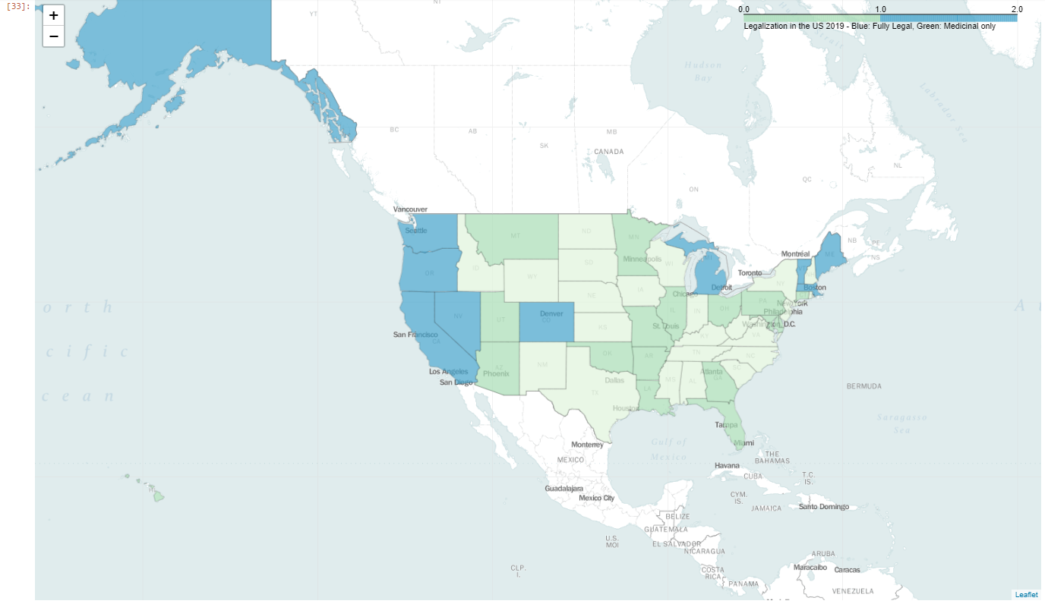
Legalization database
First the legalization status was scraped from disa.com and put into a database with Fully legalized States and Medicinally legalized states.
This data was used alongside the us-states.json data to generate a legalization map using the Folium Package
Using the Folium package I generated a map of the US to show the states where Medicinal or Recreational marijuana is legal.
Blue states fully legal
Green states medicinally legal
White states fully legal

Slide 6
Crime, Tax, & Cost of Living database
State sales tax was scraped from taxfoundation.org and set into a new taxes database
Cost of Living data was downloaded from Kaggle and set into coldb database
Of all cost of living data, only the cost of living index was taken into account for our purposes.
Crime data was extracted from the FBI Crime Statistics database for all cities with population >100,000.
Of the crime data available, only property crime was considered for our purposes.
The property crime index was standardized by dividing occurrences/population for fair comparison.
Data was then consolidated into a single cities database where it was screened to remove all cities in states where marijuana is illegal (556 -> 111 cities)
Cities database latitude and longitude data was filled using GeoPy Geolocator to be able to query the foursquare api.

Slide 7
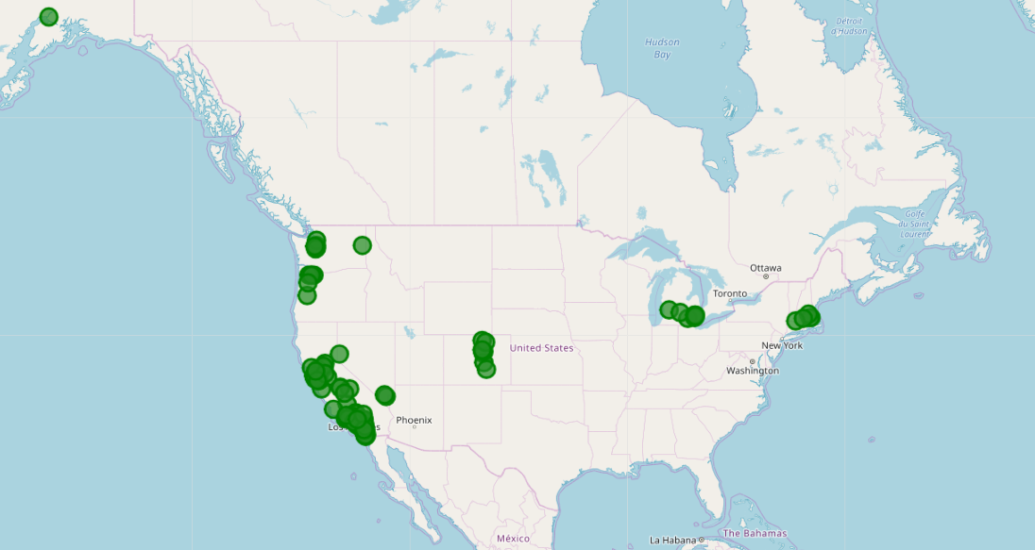
Potential Cities

Slide 8
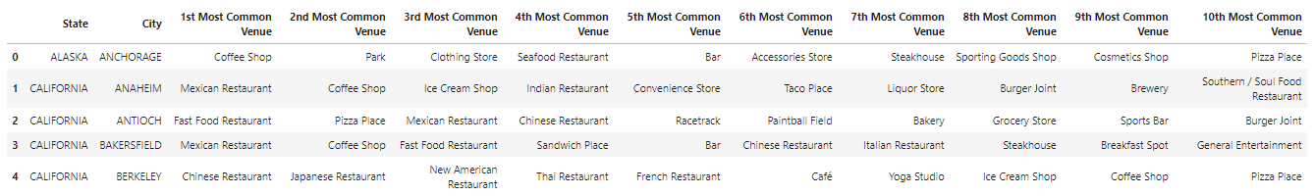
Learning the culture
Local venue data was queried using foursquare to learn about what kinds of establishments are within 1 mile of the city’s center.
Any city with a dispensary within 1 mile from center was dropped from the running.
The top 10 venues for each city based on frequency were then used for k-means clustering.

Slide 9
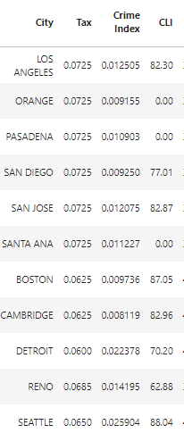
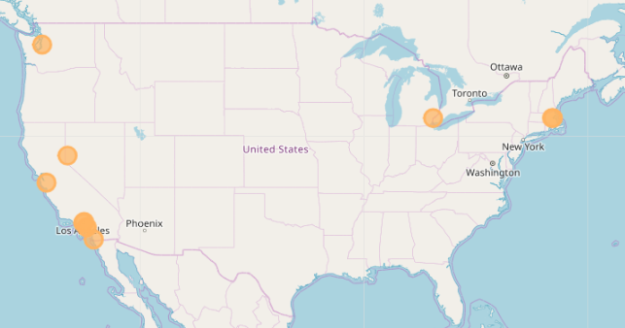
Clustering the cities
Cities were clustered using K-Means Clustering with 5 clusters to find what cities would be most conducive to our dispensary such as having active nightlife, a mature culture, a safe area, a low cost of living index.
A final cluster was found of 11 potential cities that met our criteria.
Of these 11, 3 did not have any available cost of living data and were removed from the running.
New Viable Cities

Slide 10
Results
Once the dataset was narrowed down to the final 8, the dataframe was analyzed for the lowest crime rate and the lowest cost of living to find which cities intersected.
Of the intersection, two cities tied for safest/cost of living, those two cities are Reno, Nevada and Cambridge, Massachusetts
Upon further review of the area, it was visible that Reno, Nevada had a higher density of Bars, Pubs and Breweries, indicative of a more active nightlife.
Therefore, Reno, NV was selected as the City we would like to open the dispensary in.

Slide 11
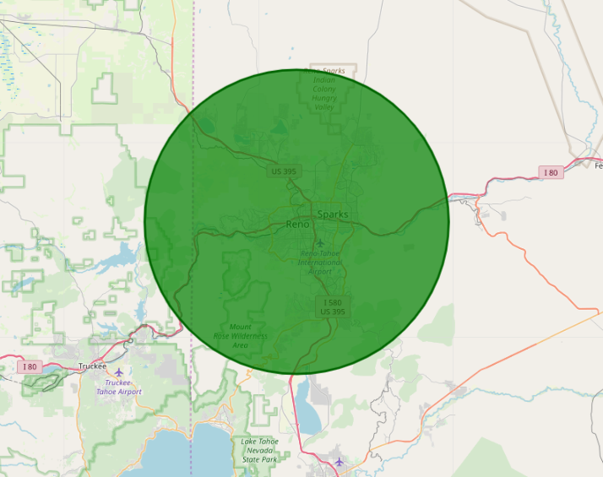
Reno, NV

Slide 12
Discussion
Upon review of the 5 different cluster datasets, I was able to determine which clusters contain the target demographic and culture that is becoming of a new dispensary, such as an active nightlife scene from bars, pubs, liquor stores, activities, lots of restaurants such as fast food and convenience stores. The recommendation would be to focus investment on opening a dispensary in Reno, NV followed by Cambridge, MA as a backup option or expansion location.
These cities are both highly populated, very trendy, have an active nightlife, are relatively safe, have moderate cost of living and have a decent state sales tax compared to other cities assessed.

Slide 13
Conclusions
Recreational marijuana is a rapidly materializing industry, estimated to surpass $16 Billion in 2019 and exponentially growing.
Based on the data reviewed and analyzed, Reno, Nevada is the top city in the US to open the next Marijuana Dispensary based on its population, safety, cost of living index and overall culture.
This is the prime chance to seize this opportunity and open a new legal marijuana supply chain in the United States.
Future opportunities to investigate
Find specific location within city
Refinement using age demographics, income, marijuana user population vs total,
Build financial case for investment

